Slide 1
HAVCO Wood Products John Vozniak – Director Field Sales and Service
Notes:
1

Slide 2
Review of Trailer Flooring Products
Introduction to HAVCO
Why Oak?
Havco Products
Sales Support

Slide 3
About HAVCO
Producing Quality 100% Oak Flooring Since 1979
Two Locations
Cape Girardeau, MO
Vonore, TN
Havco is the Largest Producer of
Trailer Flooring in North America

Slide 4
HAVCO Locations
Cape Girardeau, MO
2 hours south of St. Louis on I-55

Slide 5
HAVCO Locations
Vonore, TN Near Knoxville

Slide 6
Types of Trailer Flooring and Estimated Market Share
1. Oak 63% 2. Fusion Floor by Havco 16% 3. Maple/Canadian Hardwood 15% 4. Extruded Aluminum 4%
5. Mixed Hardwoods 1% 6. Other 1%

Slide 7
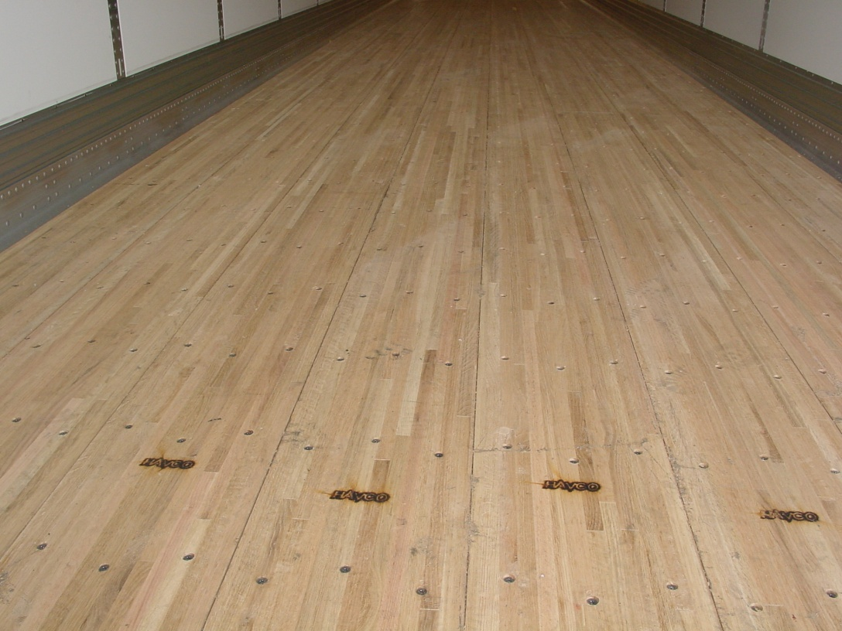
HAVCO Trailer Flooring
We use 100% Oak
OAK
Notes:
7

Slide 8
Types of Trailer Flooring and Estimated Market Share
Oak is the predominant wood used for making dry freight van (DFV) trailer floors with approximately 80% market share (including conventional wood floor and composite reinforced wood floor).

Slide 9
Why Oak? Moisture – It’s an Issue

Slide 10
Why Oak?
Oak Has Superior Strength & Durability
Long-term strength
Naturally more resistant to decay
Offers superior nailability
Plentiful and renewable

Slide 11
Issues Caused by Moisture – Decay of Hardwood
Water – It’s an issue
Decay from the under the threshold plate

Slide 12
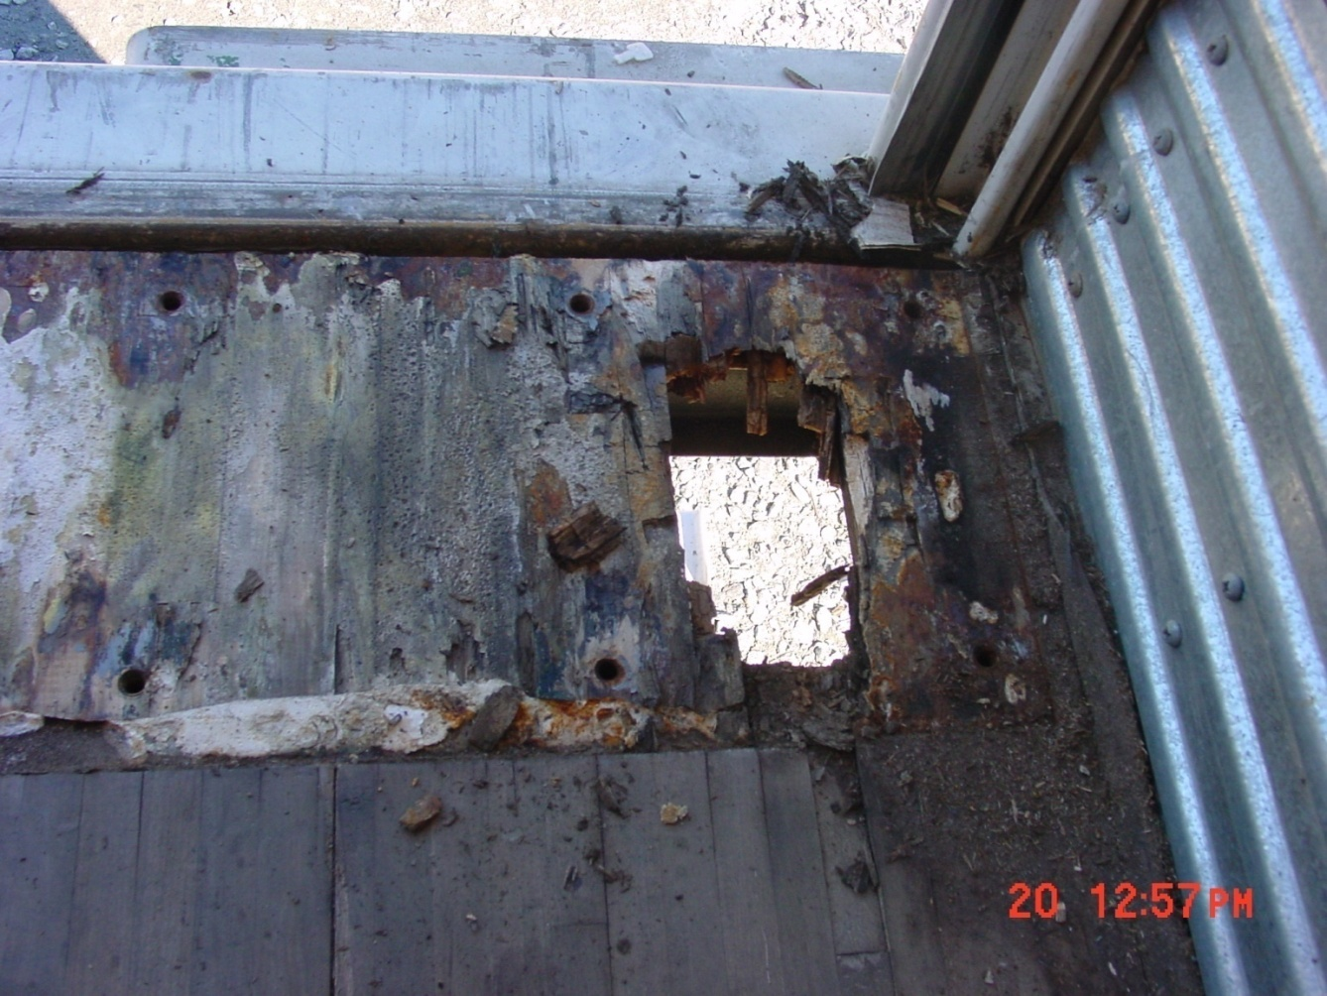
Issues Caused by Moisture
Hardwood flooring after 3 years of road service in Georgia

Slide 13
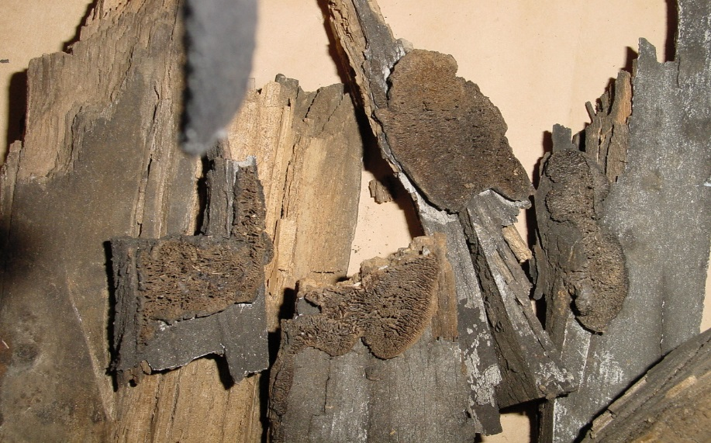
Issues Caused by Moisture – Decay of Hardwood
Severe decay of Hardwood

Slide 14
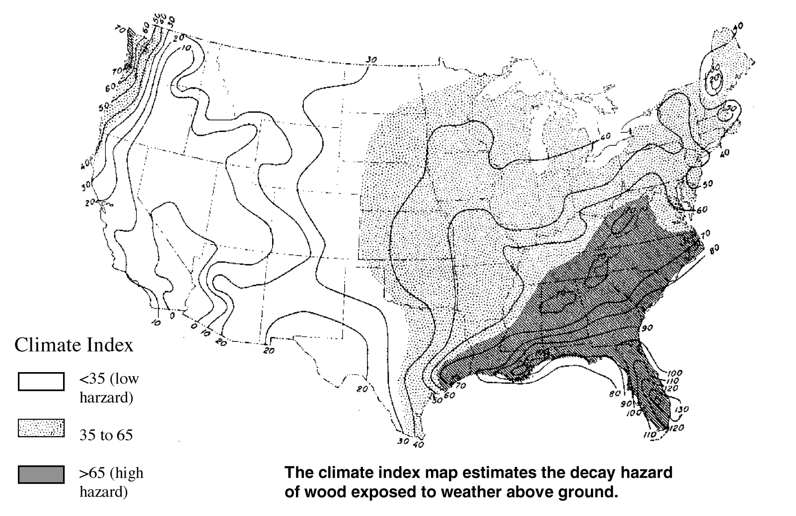
Why Oak?
Moisture affects Hardwood floors in the high decay hazard regions

Slide 15
Where Are the Best Hardwoods Plentiful?
Havco’s durable Oak comes from prime hardwood region within approximately 200 miles of our plants.
Cape Girardeau, MO
Vonore, TN

Slide 16
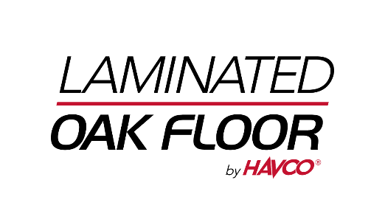
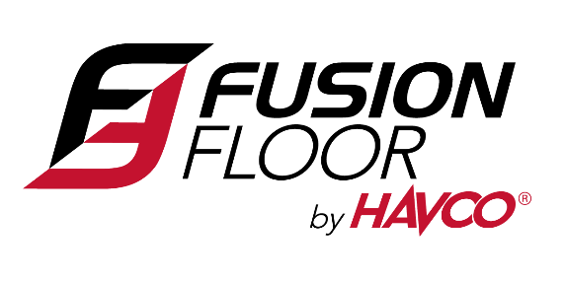
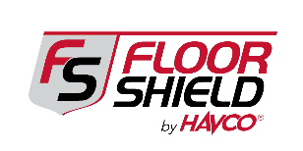
HAVCO Products

Slide 17
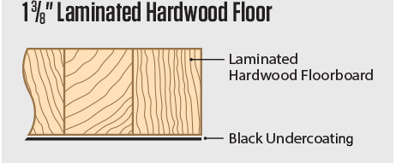
HAVCO Laminated Oak Flooring
Available with Latex Undercoating

Slide 18
Fusion Floor
Can trailer flooring last more than 10 years?
YES!

Slide 19
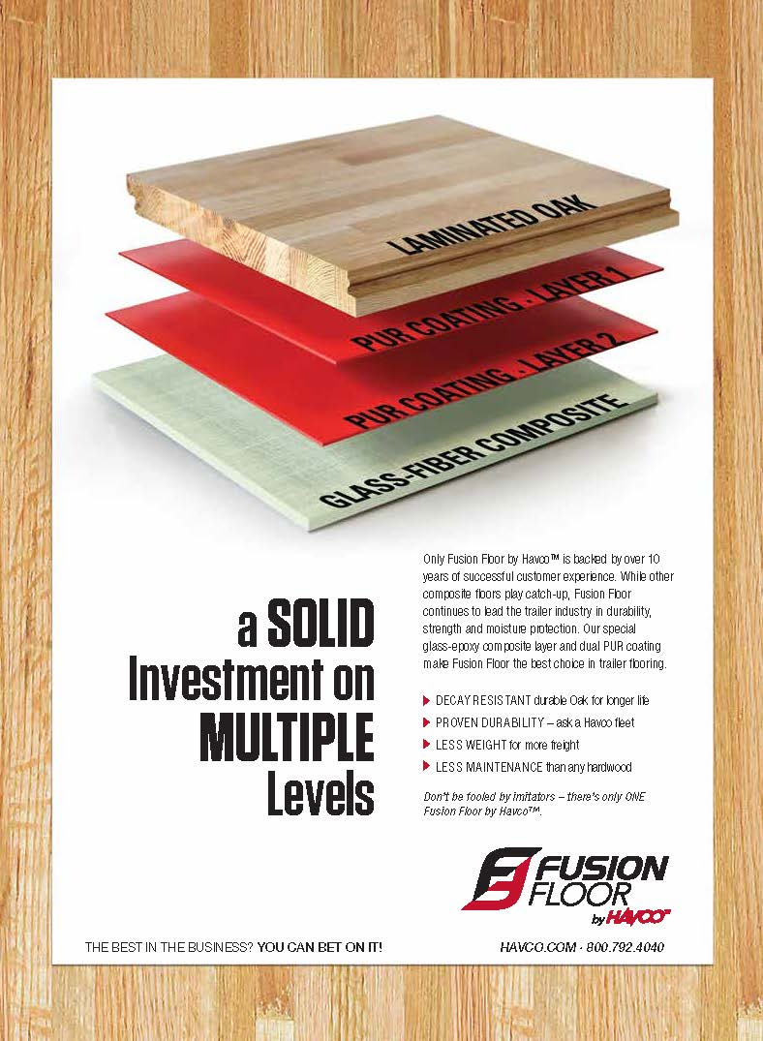
Fusion Floor is Made with Double PUR Bonding

Slide 20
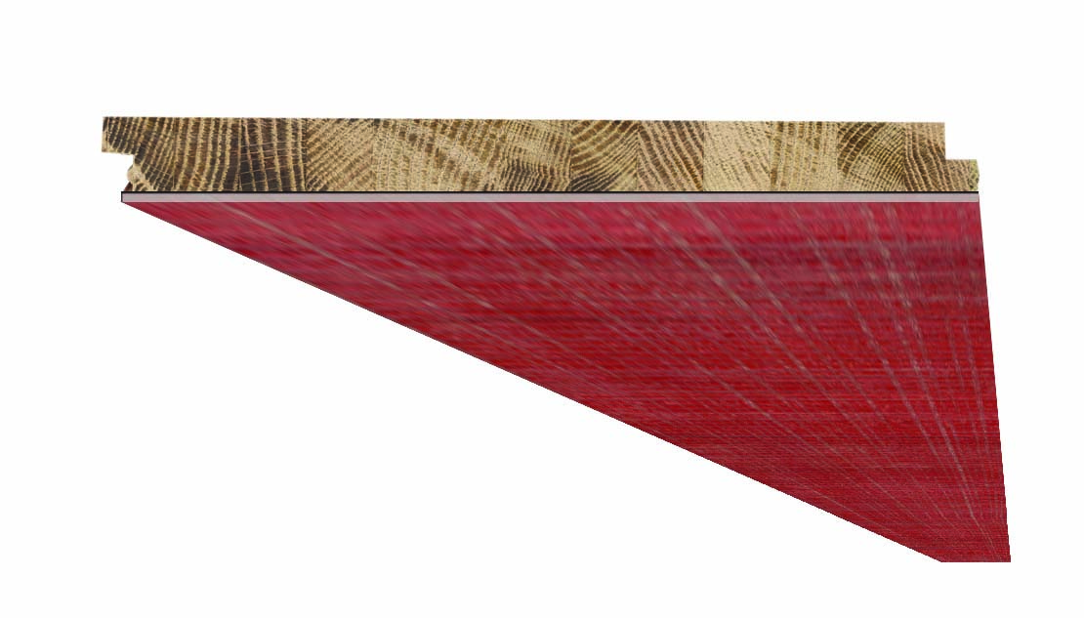
Fusion Floor by Havco
Fusion Floor starts with the natural strength and decay-resistance of our oak laminate and adds a layer of special glass/epoxy Fiber-Reinforced Composite to increase durability, reduce fatigue and provide a better ROI.
Laminated Oak Flooring and Scuff

Slide 21
Heavy Loading – It’s an Issue

Slide 22
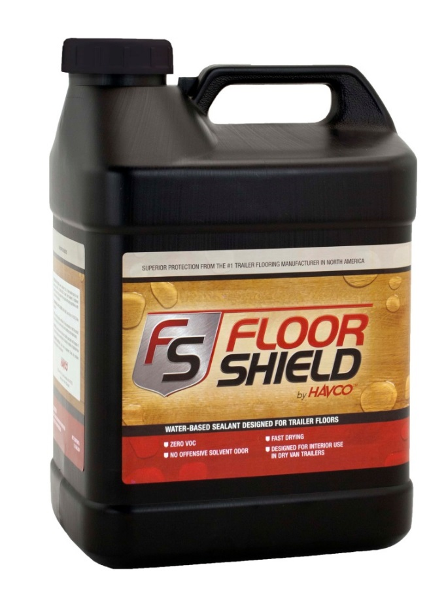
Floor Shield Coating for Protecting Top side of Flooring
FloorShield can be applied as an option in our Factory or as an aftermarket product

Slide 23
Floor Shield Coating By HAVCO

Slide 24
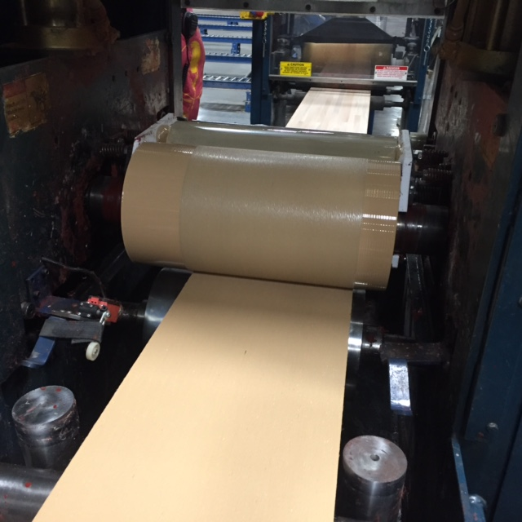
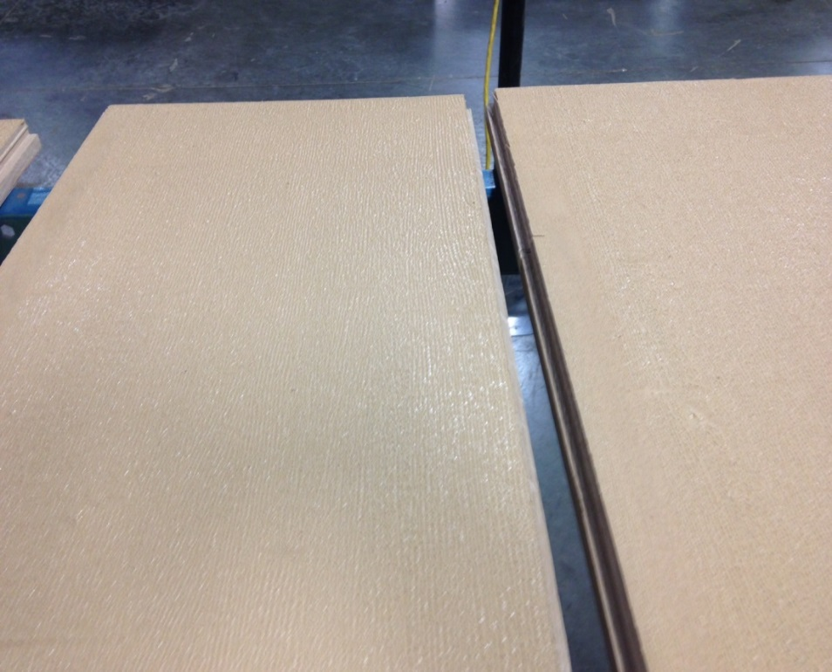
HD Topcoat / Undercoat
Laminated Oak Floor or Fusion Floor with
High Traction PUR Top coating

Slide 25
What Improvements are Customers Demanding?
Higher floor strength with less weight
Higher durability – extreme duty cycles
Improve longevity and trade-in-value
Improve waterproofing of the bottom
Water Resistant top treatments
Eliminate repair and downtime
Ease of maintenance
OEM’s adaptability

Slide 26
Questions?

