Slide 1
Meritor Overview
2019 Stoughton Dealer Meeting
Scott Hilger
Sr. Manger, Trailer
Notes:
1

Slide 2
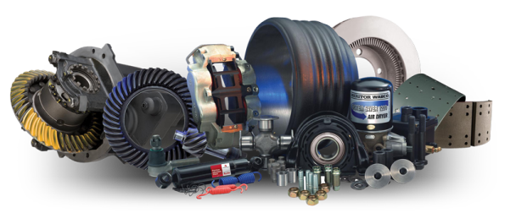
Aftermarket & Trailer Product Portfolio
Brake & Wheel End
Drivetrain
Wheel End
Driveline
Drive Axle
Brake Shoes/Kits
Hubs/Drums
Wheel Seals
Bearings
Camshafts
Wheel Bearing Adjustment System
Automatic & Manual Slack Adjusters
Wheel Attaching Components
Universal Joints
Center Bearings
Tubing
Yokes
Flanges
Spline Plugs
Bearing Stub Shafts
Yoke Shafts
Axles
Differentials
Gear Sets
Gearing
Seals and Bearings
Overhaul Kits
Axle Shafts
Clutch
Transmission
14" Assemblies
15.5" Assemblies
Clutch Brakes
Installation Kits
Other Accessories
Transmissions
Gearing
Seal and Bearing Kits
Overhaul Kits
Input Shafts
Disc Brake (Hydraulic and Air)
Calipers
Rotors
Wheel Cylinders
Brake Hardware
Disc Pads
Steering & Suspension
Steering
Air System
FastSet™ No-Ream King Pin Kits
Genuine & All-Makes King Pin Kits
Tie Rod End Drag Links
Cross Tubes
Steering Arms
Compressors
Air Dryers
ECUs
Valves
Cartridges
Sensors
Trailer Axle and Suspension
Trailer Axles
MTA Suspensions
RFS Beams
Bushings
Meritor Tire Inflation Systems (MTIS)
Shock Absorbers
Air Springs
Equalizers
Torque Arms
Hanger Brackets

Slide 3
Aftermarket Distribution Network
Meritor Distribution
786,000
sq. ft.
51,000
700+
more
than
26
operation
SKUs stocked
9,400
calls handled
languages
18,000
per day
supported
2,000
lines shipped
suppliers
ship-to locations
per day
Meritor Remanufacturing
per day
per week
per month
per year
recycle
refurbish
use
produce
240,000
120,000
13.3 million
six million
pounds of steel
brake cores
rivets
brake shoes
Meritor Provides a Competitive Advantage for its Distribution Partners
One of the lowest transaction costs in the industry
Logistics efficiency/ability to connect electronically
Broadest brake, wheel-end, drivetrain, steering and suspension portfolios

Slide 4
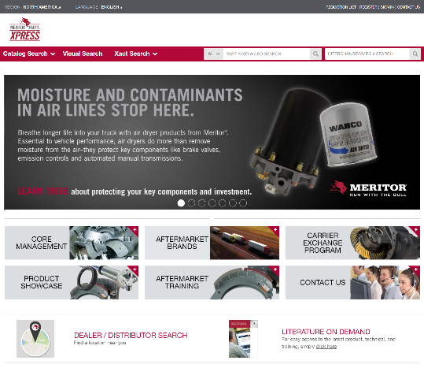
MeritorPartsXpress.com Overview
Search over 1000,000 parts
Detailed Product Specs
Visibility to Inventory
Over 40,000 VMRS Codes
Bill of Materials Info
Mobile Responsive Design
Intuitive User Experience
Visual Search with Exploded View Diagrams

Slide 5
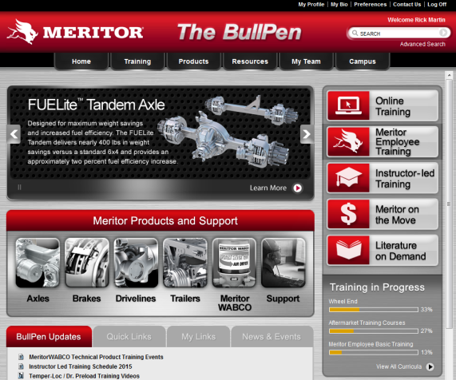
Meritor Bullpen – Online Resource
Meritor Products & Support
Axles
Brakes
Drivelines
Trailer
Meritor WABCO
Online Training
Instructor Led Training
Literature on Demand
Updates
Quick Links
My Links
News & Events
Training Progress

Slide 6
Literature on Demand
All of your literature needs!

Slide 7
Meritor Links and Contact Information
www.meritorbullpen.com
www.meritor.com/literature-on-demand
www.meritorpartsxpress.com
Florence Customer Care: US: 888-725-9355. Canada: 800-387-3889
Scott Hilger
Sr. Manager, Trailer
Cell – 402.618.4282
Scott.Hilger@Meritor.com

