Slide 1
Stoughton Parts Sales 2019 Customer Appreciation Event
Ridge Corporation
Zach Rittler, Sales & Marketing Manager

Slide 2
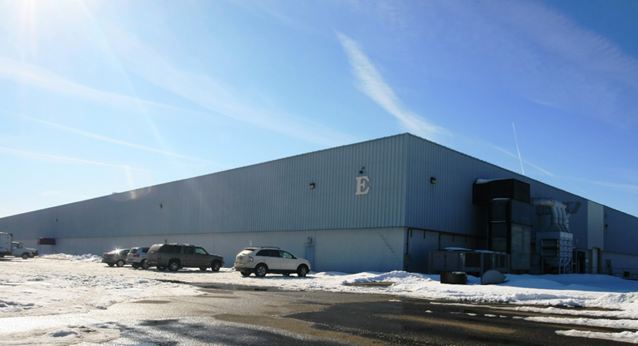
About Ridge
HQ - Zeus Facility, Pataskala, OH
Apollo Facility, Frazeysburg, OH
Sr Management, Engineering, Manufacturing, Purchasing, Customer Service, Sales
Manufacturing

Slide 3
Locations

Slide 4
Tools & Resources Available
Nationwide, knowledgeable sales group
Customer Fulfillment group
Sales@RidgeCorp.com
Ridge website – NEW!
Http://www.RidgeCorp.com
YouTube channel for product and maintenance videos
Your logo here

Slide 5
Ridge Product Portfolio
Your logo here

Slide 6
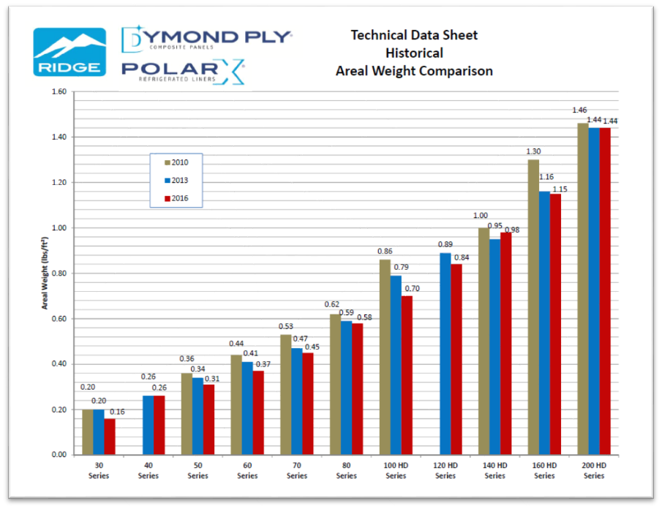
Series Materials

Slide 7
Series Materials

Slide 8
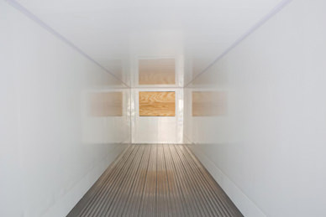
Royal Watson™
Show surface, glossy white appearance
Rated for Direct Food Contact per FDA standards
BioStat technology, prohibiting bacterial and/or fungal growth for the life of the trailer
Protects against stains and unwanted odors
Easily cleaned with all FDA compliant cleaners per industry best practices
Universal bonding ability, optimized for urethane paints and adhesives
Standard on all Series materials & SolarX translucent roof

Slide 9
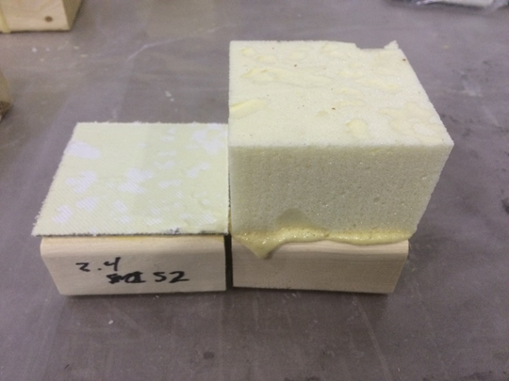
Surlok™
Interior, functional surface optimized for PU foams and adhesive
Chemical/structural bond, much stronger than mechanical bond
Foam now the weak link, Dow Chemical tested and verified
Protects the insulating foam from moisture intrusion and degradation
Seals off any foam outgassing
Standard on all Series materials & SolarX translucent roof
x
Scrim Cloth = Mechanical Bond

Slide 10
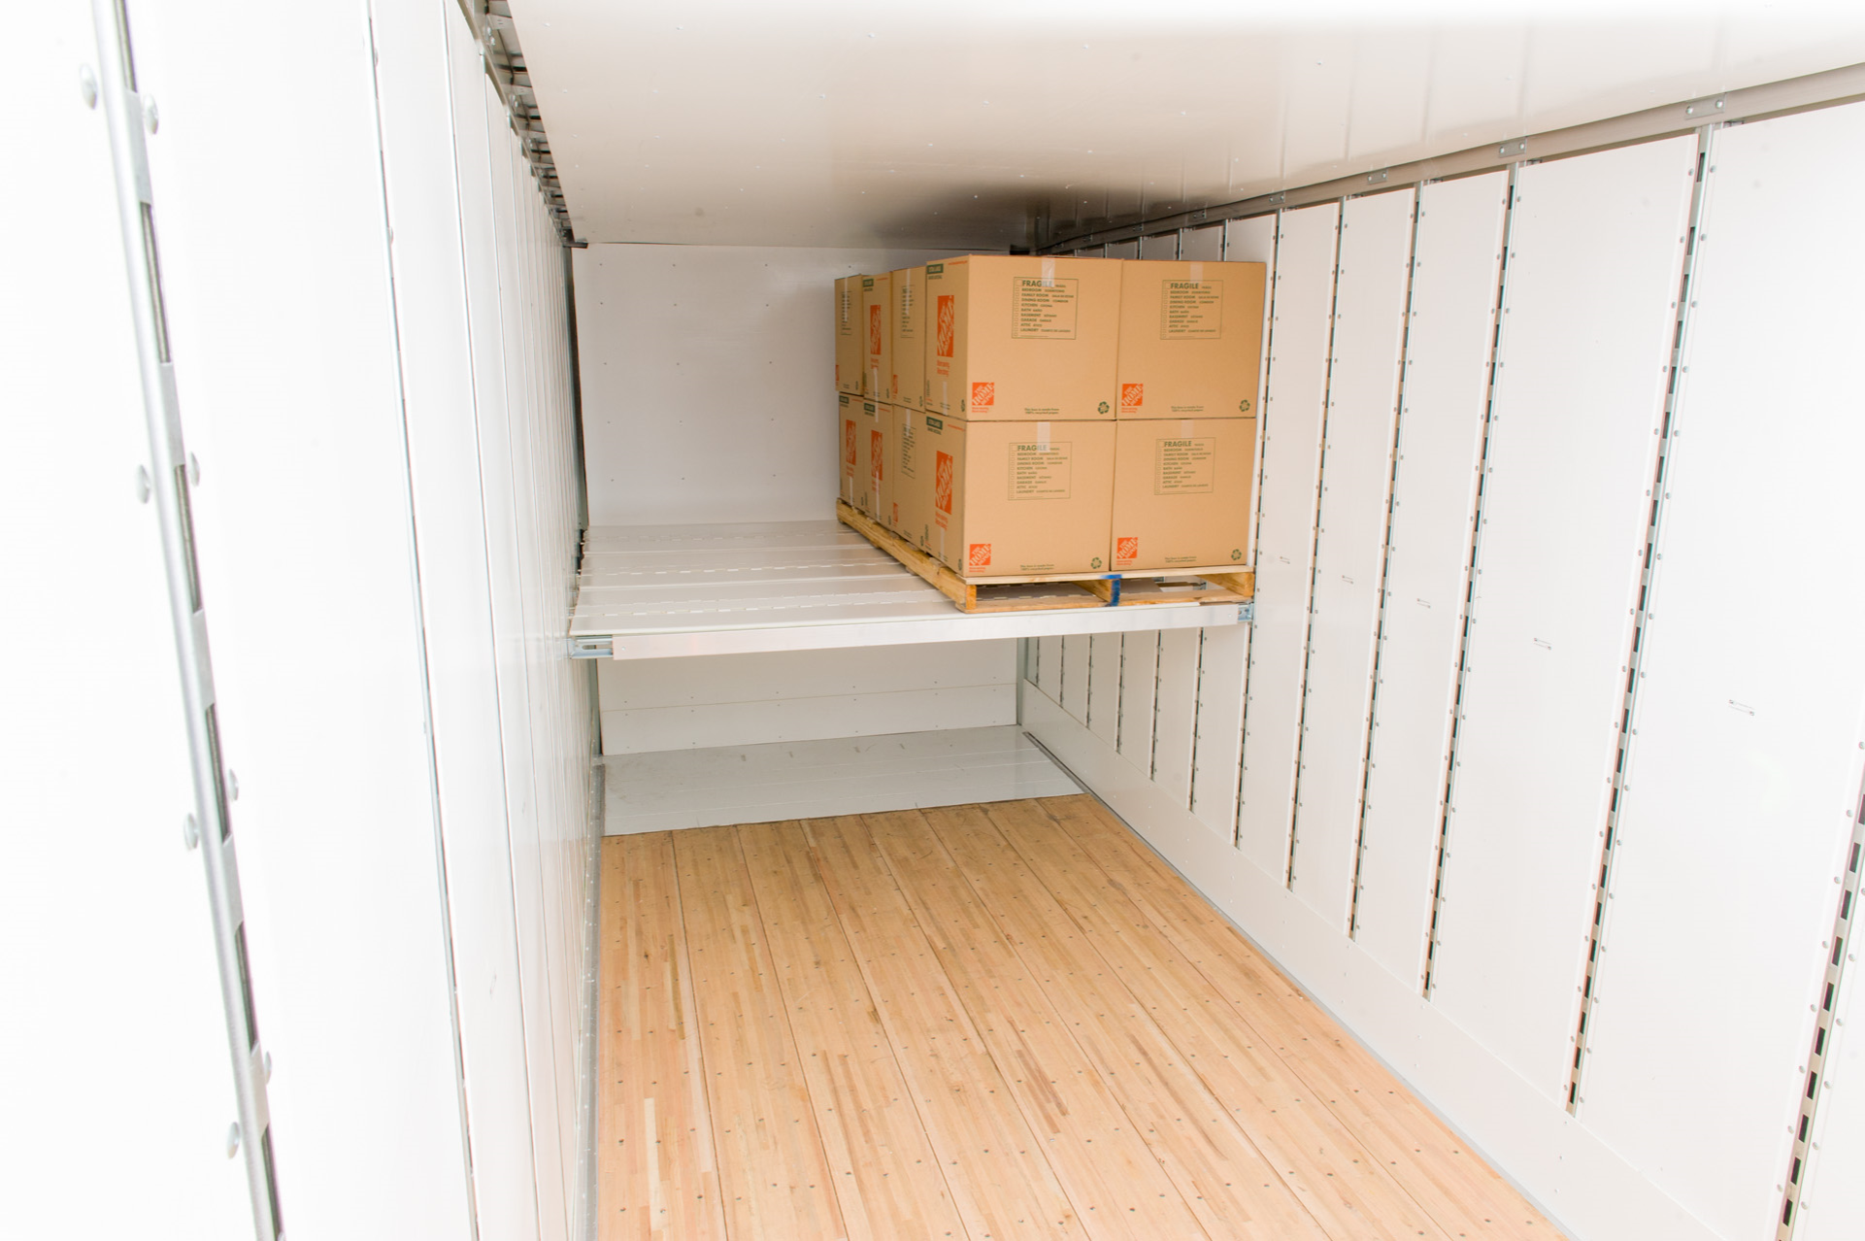
DymondPly™ Dry Van Lining Systems
Made up of Ridge Series materials featuring Surlok and Royal Watson surfaces
Stronger (abrasion and puncture resistance) than traditional materials, at much less weight
Hydrophobic, resists corrosion, mildew, degradation, and can be easily cleaned
Different panel profiles available to mount to different post profiles
HD Series features a woven reinforcement structure on exterior surface for wear and abrasion protection for use in front wall and scuff band applications

Slide 11
PolarX™ w/ BioStat™ Refrigerated Van Liners
Patented ultrasonic welded integral scuff and wall
BioStat Technology
FDA compliant to Direct Food Contact standards
Universally bondable, integral wall; Surlok™ and Royal Watson™; Dow Chemical tested for max foam adhesion
Chemical bond to PU foams and adhesives, much stronger than scrim cloths
High impact and far better abrasion resistance when compared to aluminum or FRP
Industry leading strength to weight ratio
100% Recyclable

Slide 12
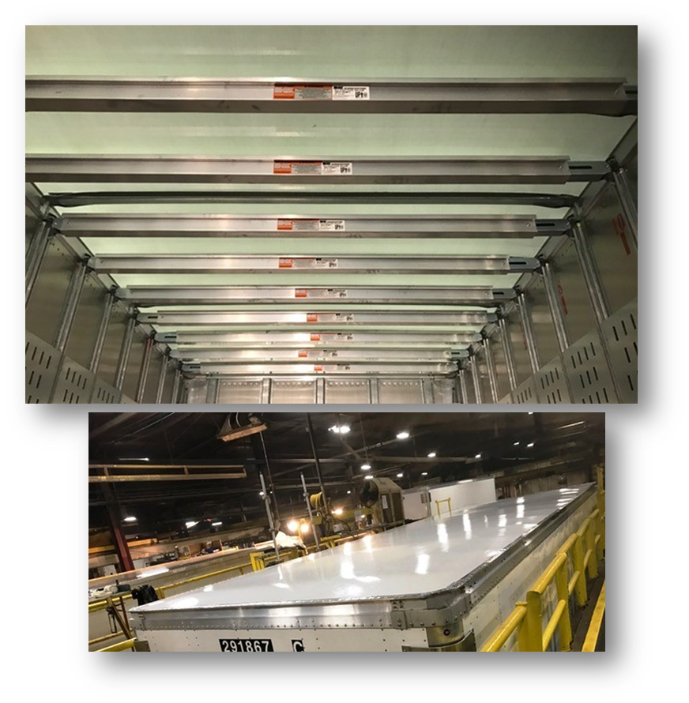
SolarX™
Unique layup of Ridge raw materials, featuring Royal Watson and Surlok surfaces
Provides a bright interior; especially when paired with DymondPly liners, front walls, and scuff
Higher strength and lighter weight than traditional roof sheet, including .040 aluminum!
Will not become brittle or darken over time
100% Recyclable materials like all Ridge products

Slide 13
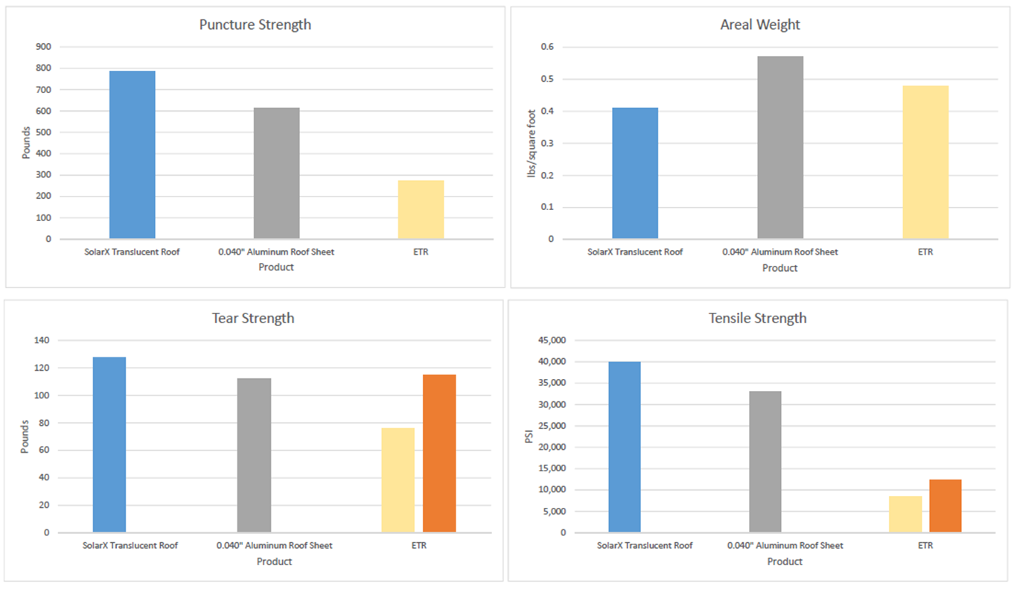
SolarX™ – Benchmark Comparisons

Slide 14
SolarX™ – Tear Strength!

Slide 15
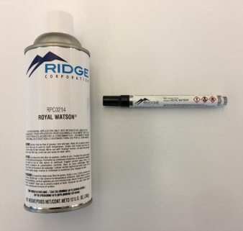
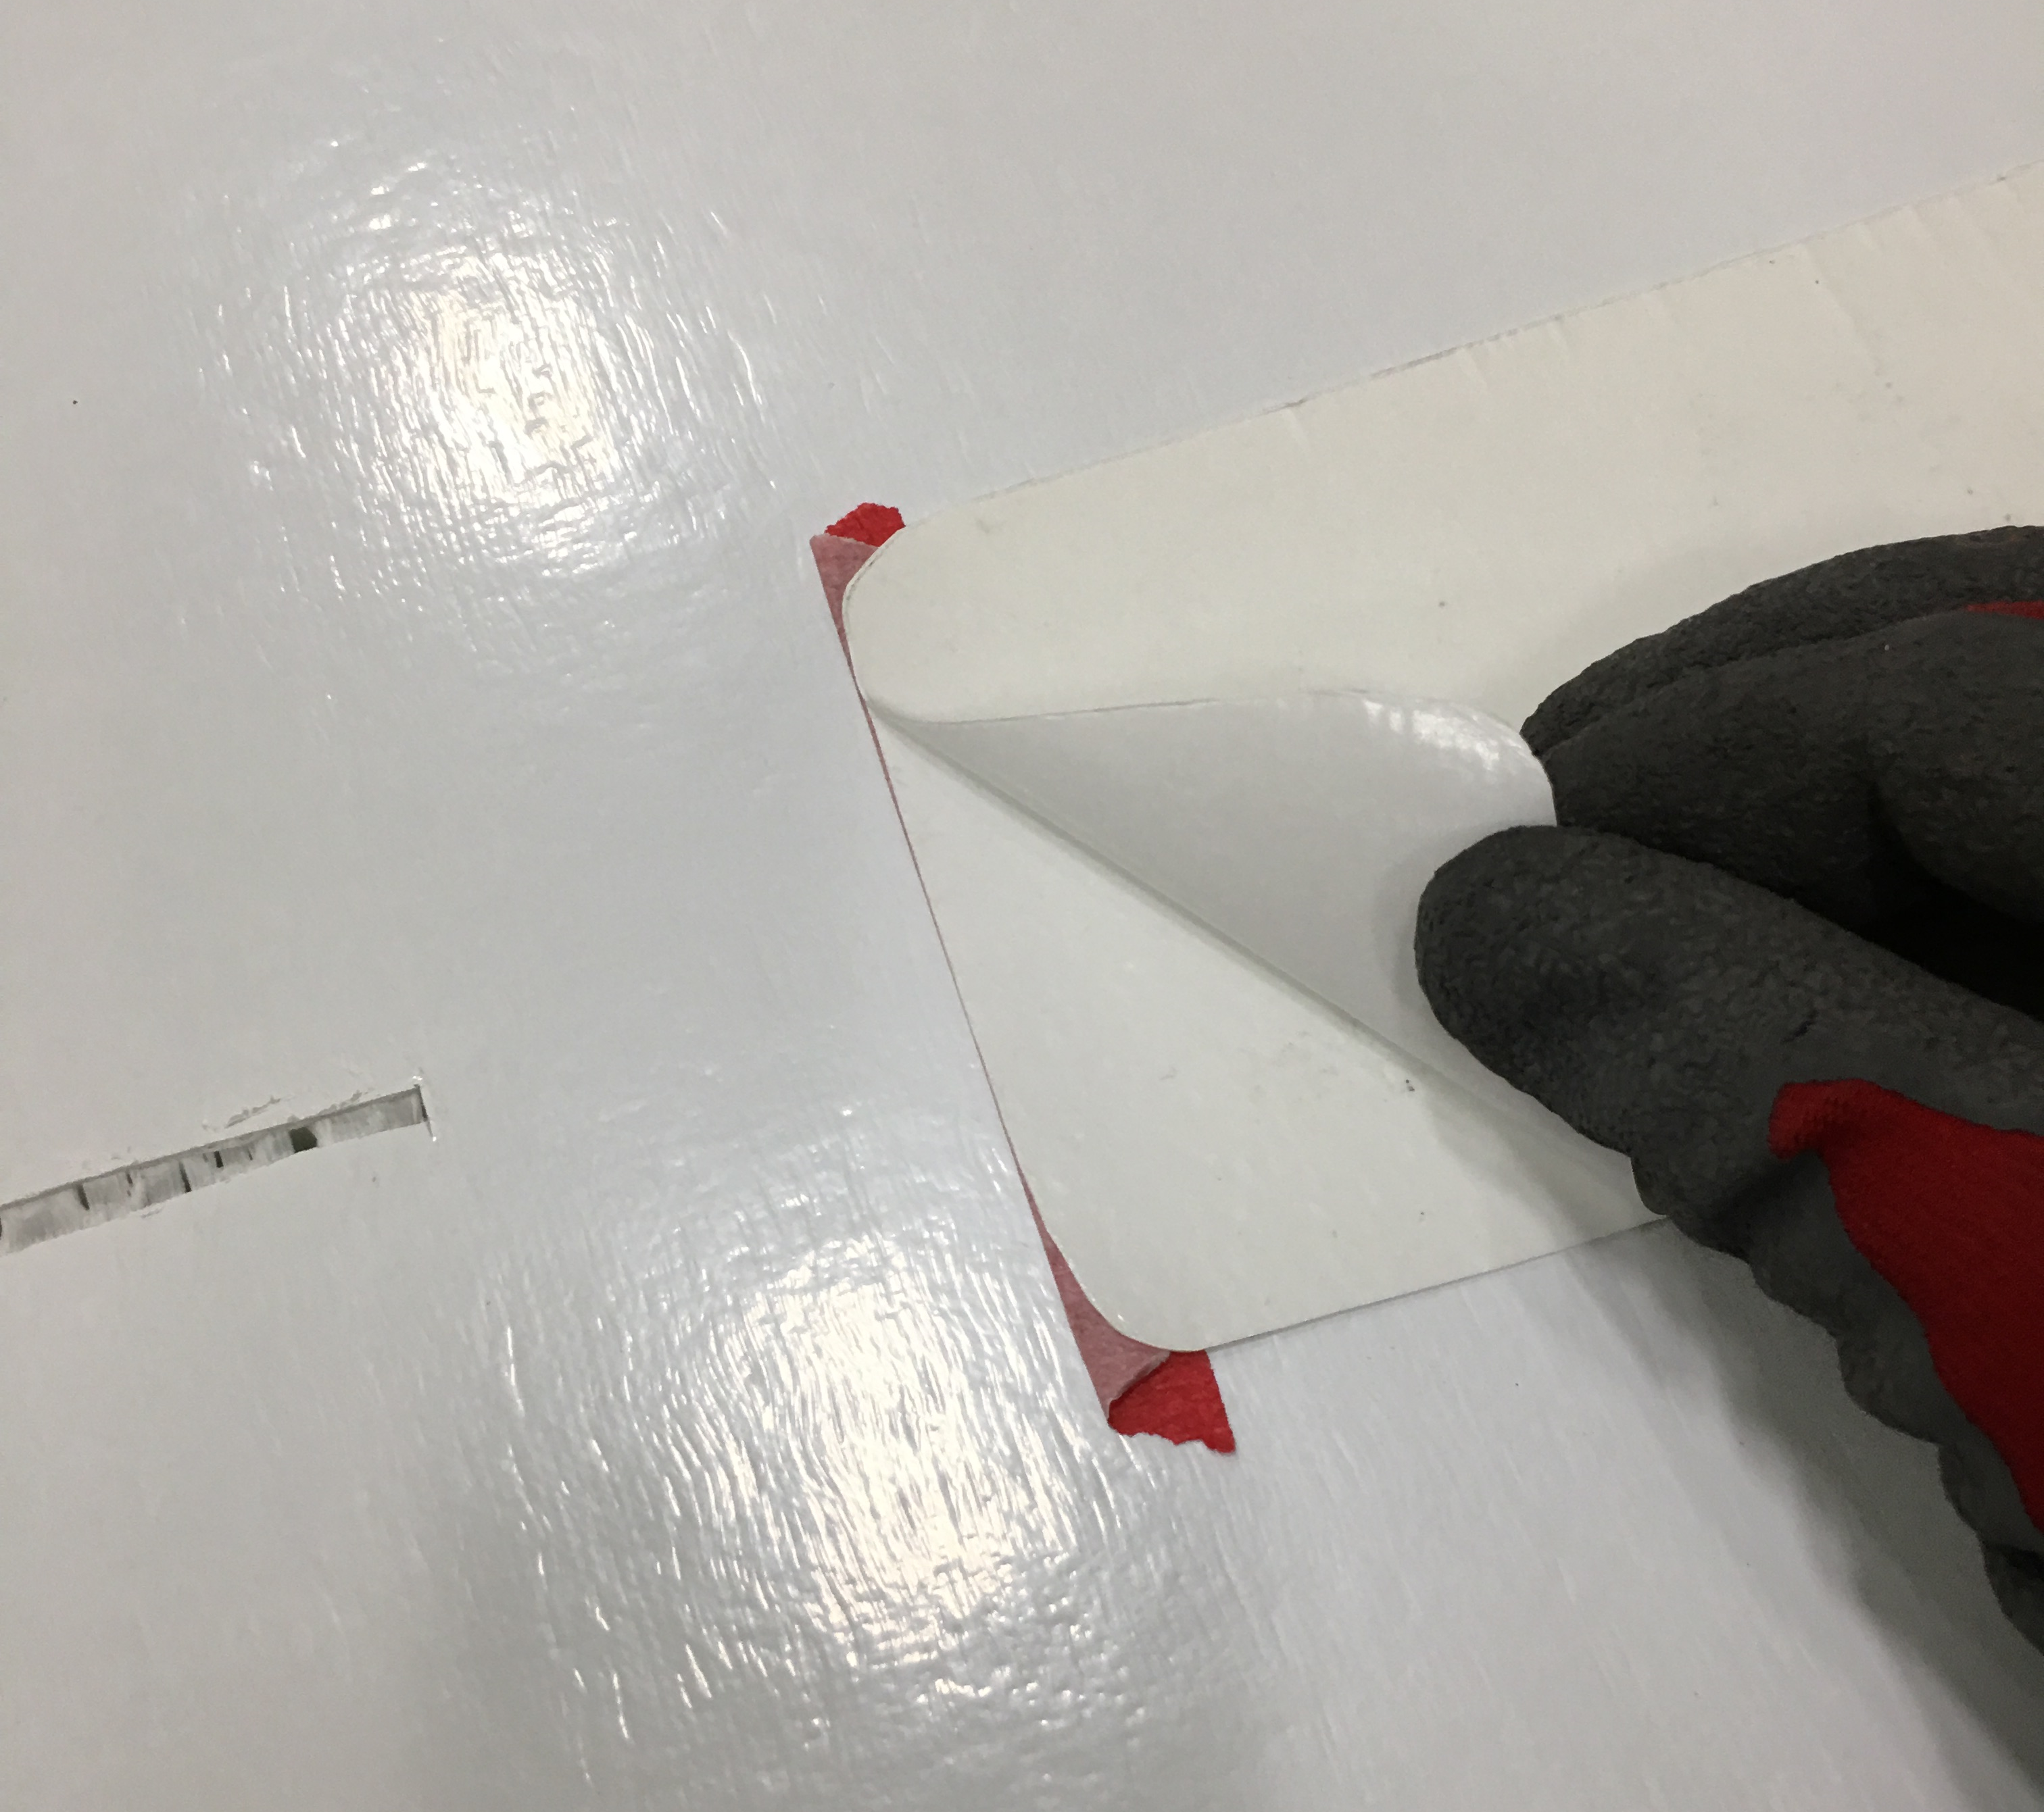
Quick & Easy Repair
No messy, smelly resins
Options available…
Aerosol and pen available for touch up
Part# RPC0213 or Item# RRPC0213
Part# RPC0214 or Item# RRPC0214
Peel ‘n Stick patch – EXCLUSIVE
Royal Watson & Surlok Surfaces ONLY
Part# RRK000300W
Detailed repair instructions and training available for service shop personnel
Contact Ridge for repair on non-Royal Watson surface
All repair materials available at Stoughton Parts!!

Slide 16
GreenGap™
Gap fairing to close up space between tractor and trailer for seamless transition on three sides
Shape designed to allow max turning radius and surface for air attachment
Easy access to glad hands and 7 way connector
Royal Watson™ surface for aesthetics and allow bondable surface for graphics
Series 80 material for resilience and flexibility in event of impact
Cut outs at top to provide clearance for lights
Lightweight for easy install
Part# RAC0090

Slide 17
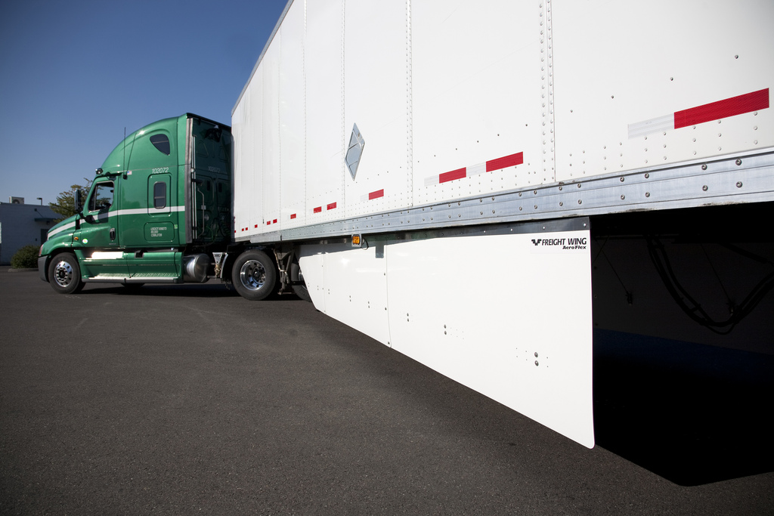
FreightWing™
The “original” trailer skirt
Three piece design
Light weight glass reinforced, thermoplastic material, 100% recyclable
Quick, easy install
Now with V-Brace™ technology
EPA SmartWay verified & CARB Compliant
Primarily aftermarket/retrofit offering
Part# RAC0094 or Item# RRAC0094

Slide 18
GreenWing™
Light weight glass reinforced, thermoplastic material, 100% recyclable; less than 155 lbs total kit weight
Ground clearance arc on GreenWing™ for recessed docks
Quick, easy install
V-Brace™ technology
Exclusive hem support design for added strength on GreenWing™
Greatest surface area coverage
Best value = shortest ROI, providing industry’s best fuel savings
EPA SmartWay verified & CARB Compliant
Dry Van Part# RAC0012W or Item# GREENWING-KIT
Reefer Van Part# RAC0012 or Item# 04-86970-000-19

Slide 19
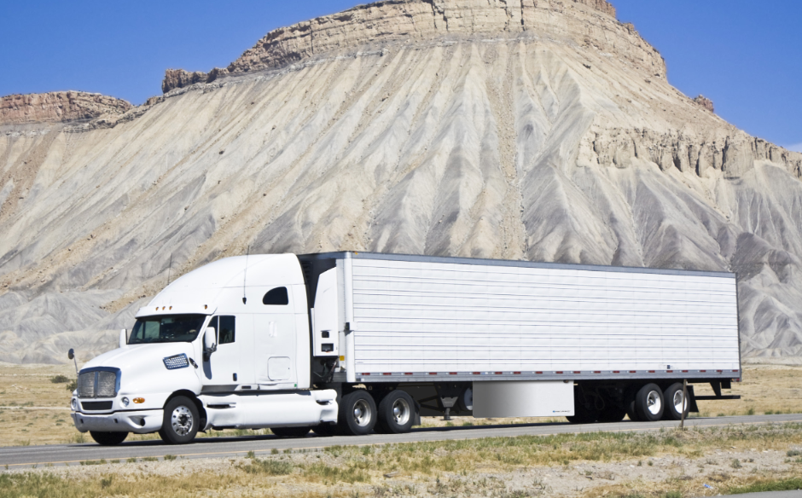
NEW! - GreenWing Bin III
CARB/GHGII Approved
Total kit weight less than 90 lbs
V-Brace Technology
The resilience and durability you expect from GreenWing!
Part# RAC0179
CARB/GHGII
Approved!!

Slide 20
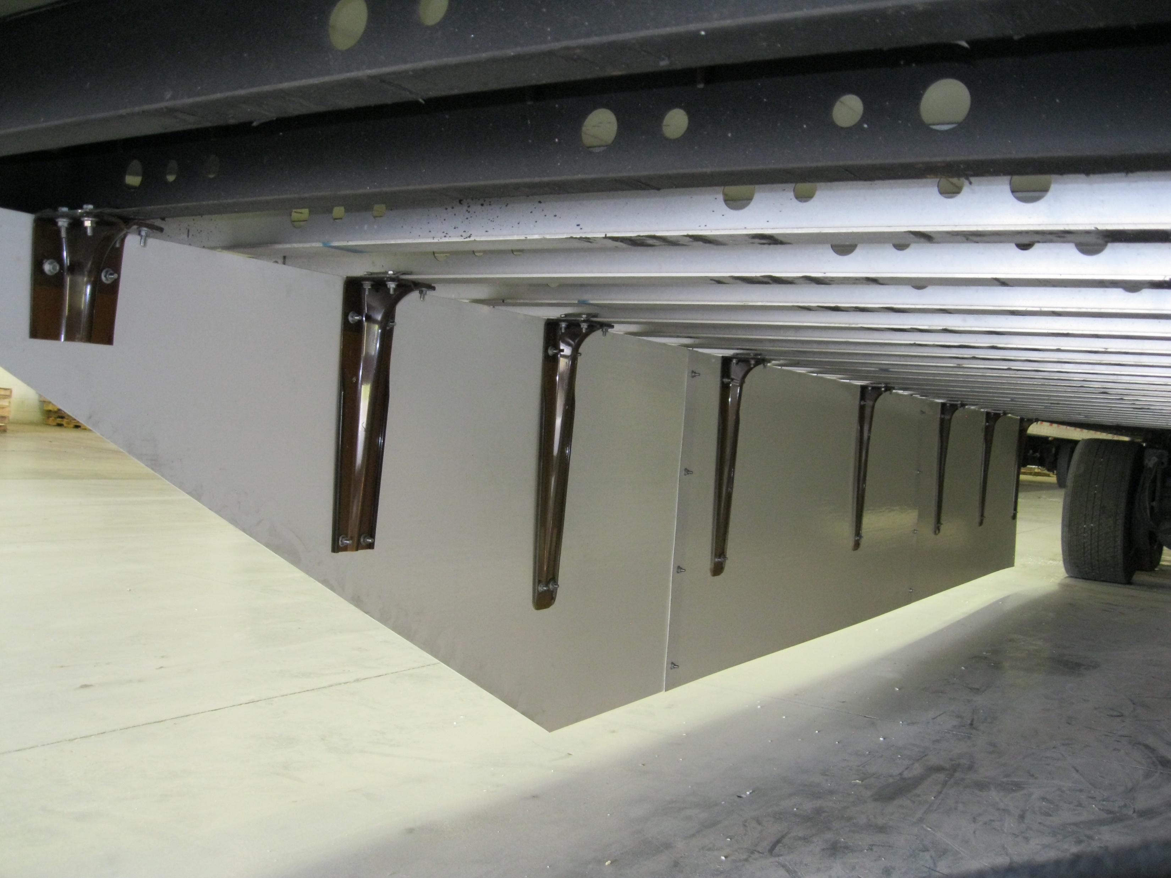
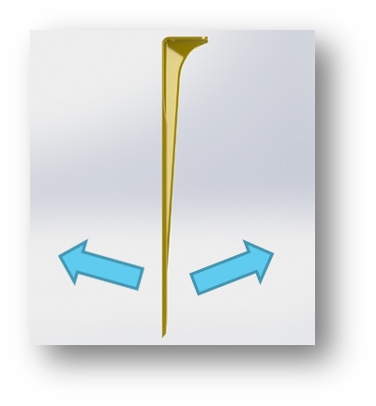
V-Brace™ Technology
Standard on GreenWing and Gen2 FreightWing trailer skirts
Unsurpassed resilience
Advanced engineered composite material for maximum strength and flexibility, both inward and outward
Standard on all GreenWing™ skirts
Patented technology
GreenWing™ with V-Brace™ provides closest to the ground coverage in the industry, closer to the ground = FUEL SAVINGS
Part# RAC0023 or Item# RRAC0023

Slide 21
GreenWing - RESILIENCE

Slide 22
THANK YOU!
QUESTIONS?

