Slide 1
Stoughton Parts Sales 2019 Customer Appreciation Event
Steve Kollins - Territory Sales
Randy Lowry - OEM Sales

Slide 2
SAF-HOLLAND is one of the leading global manufacturers and suppliers of high-quality systems and components for commercial vehicles.
Over 100 years of experience - making improvements that are sensible and provide better solutions for our end users.
Partner with Stoughton Trailers – 1st CB suspensions.
Continuous improvement in plant practices, processes, efficiencies – to become better partners with all customers.
THINK AHEAD is not just a slogan for SAF-HOLLAND – it is a real passion. That is why we are leading the way on ENERGY, PEOPLE and the ENVIRONMENT.

Slide 3
Partners in Progress What Stoughton Parts Dealers need to know
New Phoenix PDC: 45,000-square-foot facility, opening later in September, will provide capabilities to more efficiently supply replacement parts to distributors and dealers.
New products: Gold Line, Saturn LG, SC5 Wheel Ends, +++++++
New Aftermarket Programs
New POD - Parts on Demand - On Line, Part Numbers + you need!
Air Disc Brakes for Trailers = Growing market!
SAF-Holland Gold Line = opportunity to grow your market share
Lead times getting better!

Slide 4
How we go to market

Slide 5
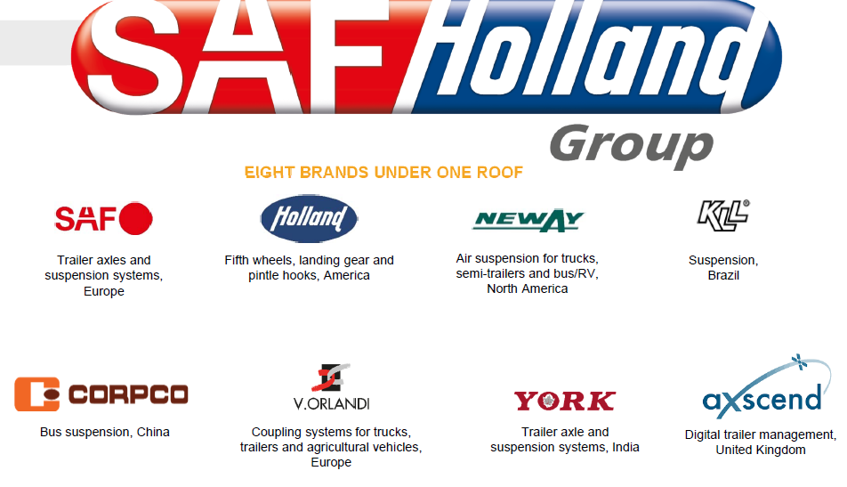
SAF-Holland – 8 Brands under one roof

Slide 6
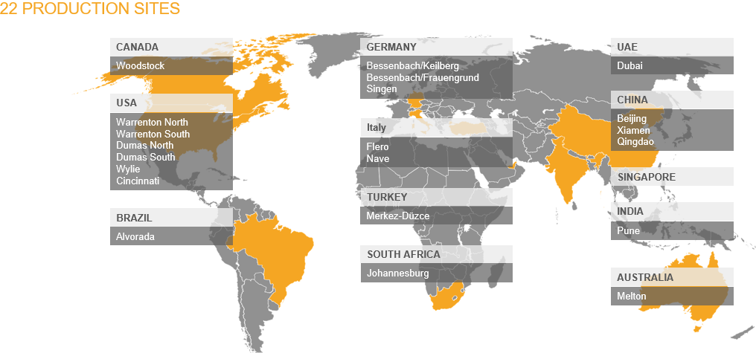
SAF-Holland = Global Company

Slide 7
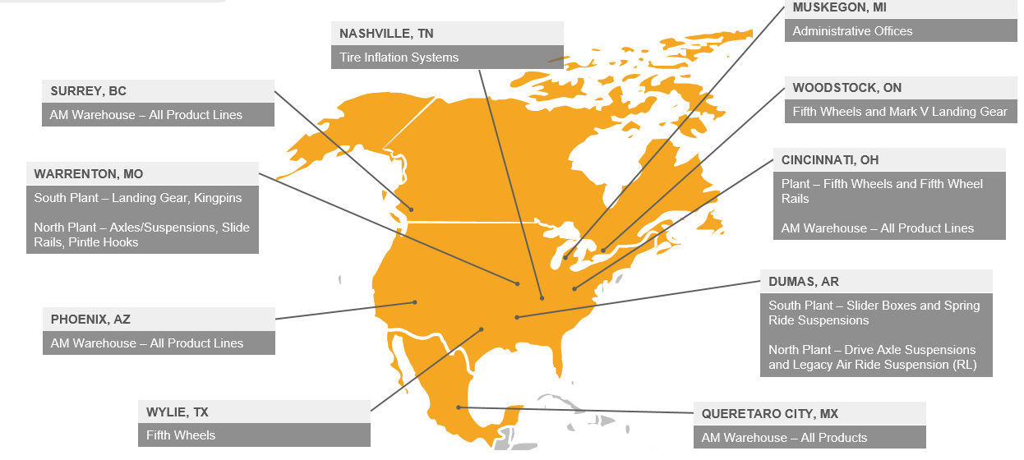
SAF-Holland North American Facilities

Slide 8
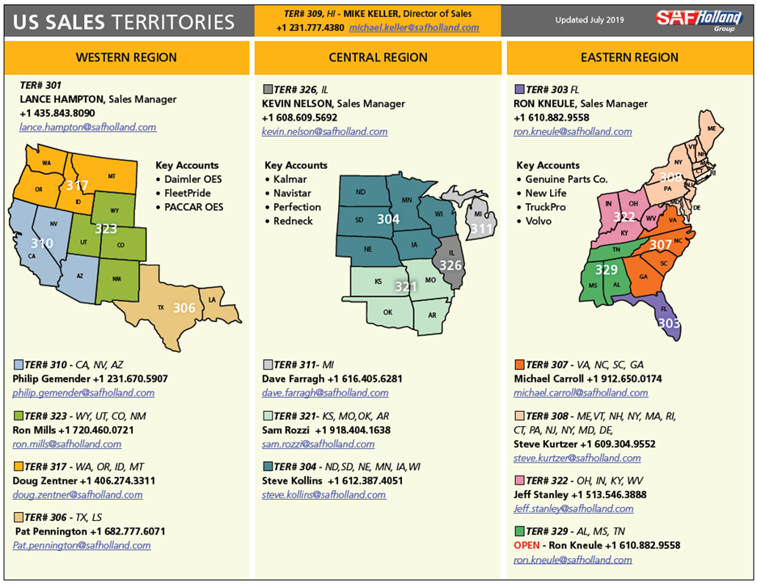
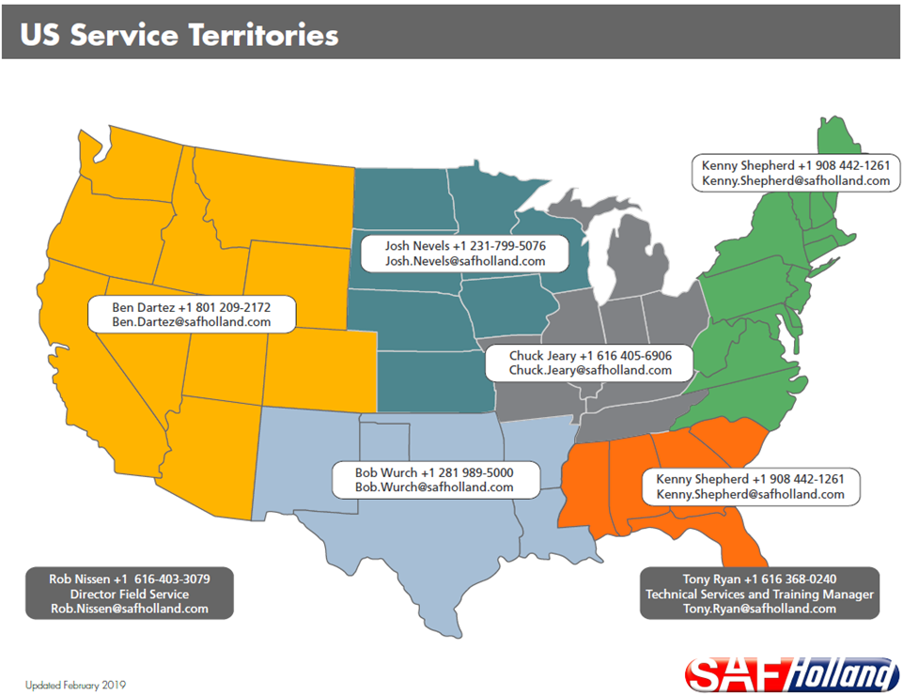
SALES AND SERVICE SUPPORT TEAM

Slide 9
SAF-Holland Family Of Products
You have access to ALL products!

Slide 10
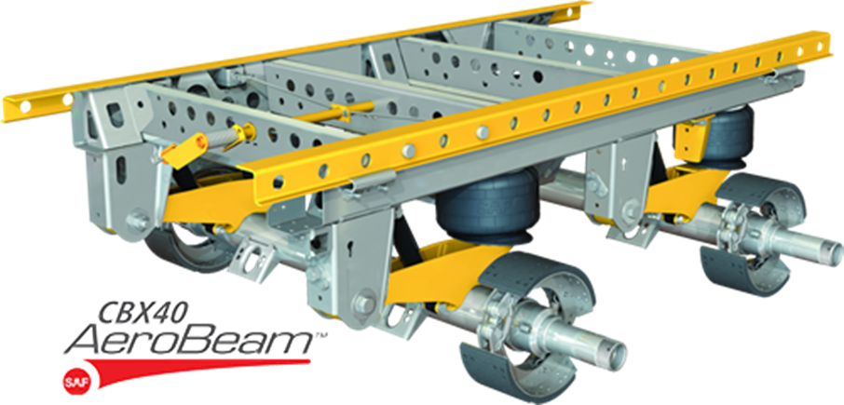
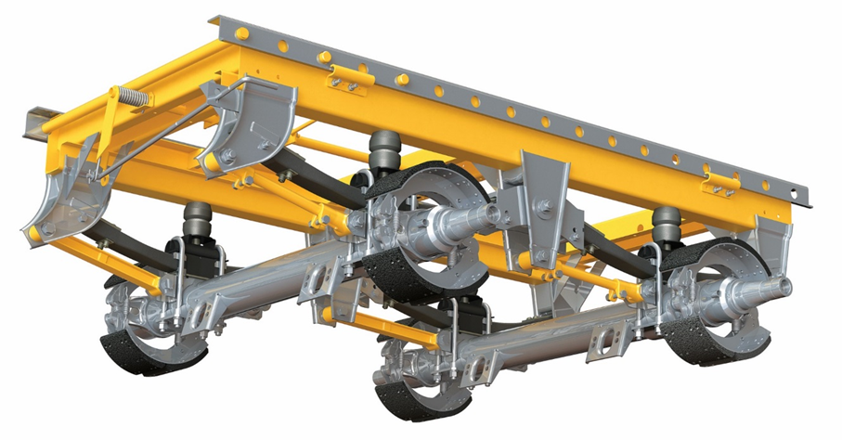
Trailer Suspensions
– CBX Air Ride Slider
ULX40

Slide 11
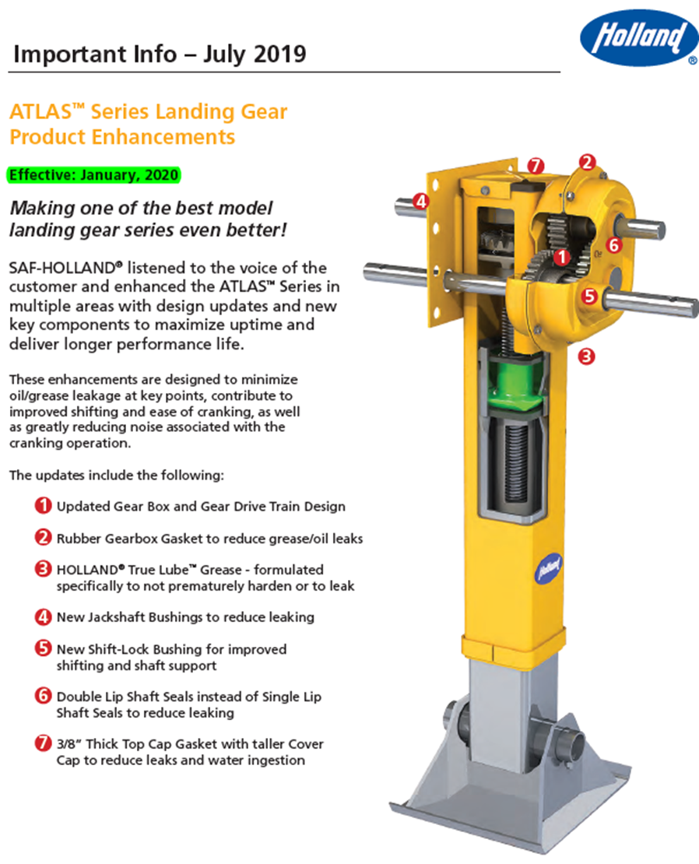
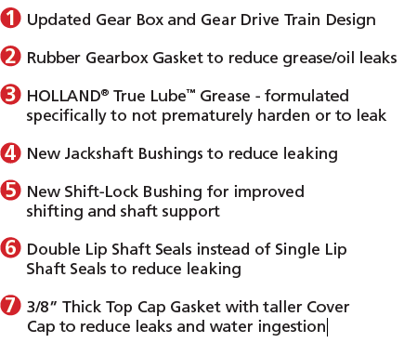
Landing Gear – Atlas Enhancements 2019

Slide 12
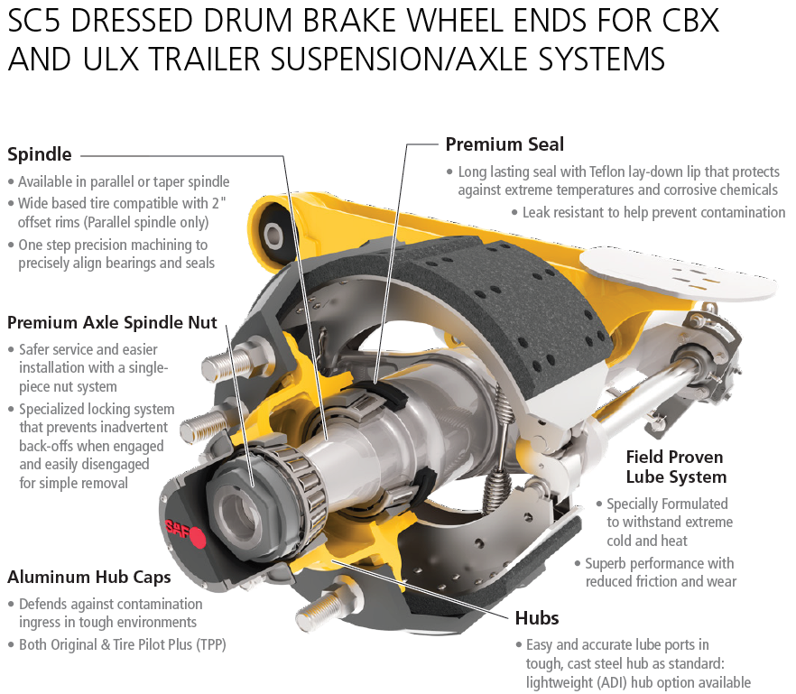
NEW SC5 Wheel Ends
SAF SC5 Dressed Drum Brake Wheel End Package for CBX and ULX Series
Trailer Suspension and Axle Systems with 5 Year Parts and Labor Warranty

Slide 13
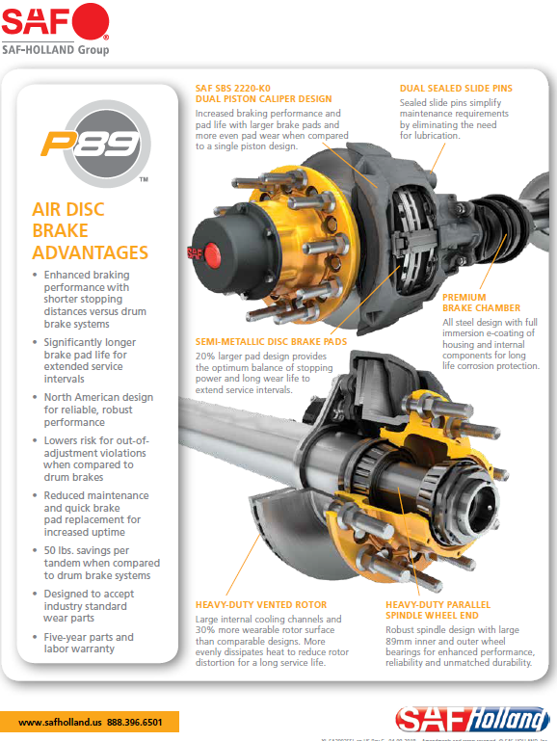
Air Disc Brakes

Slide 14
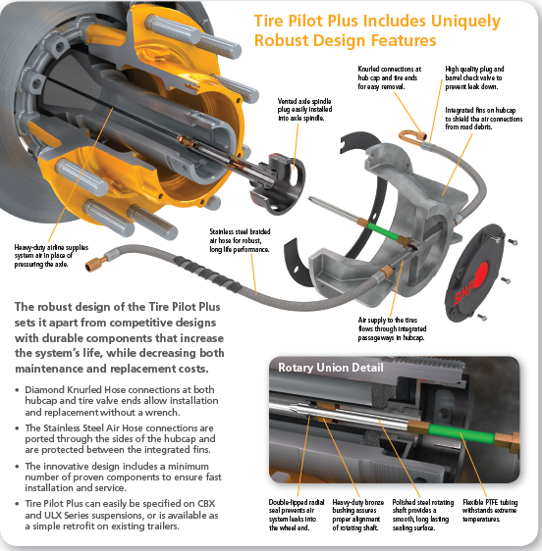
Tire Pilot Plus
Tire Pilot Plus
not only controls pressure through inflation,
but also maintains equal pressure across all wheels
and features high pressure
relief for overinflated tires.

Slide 15
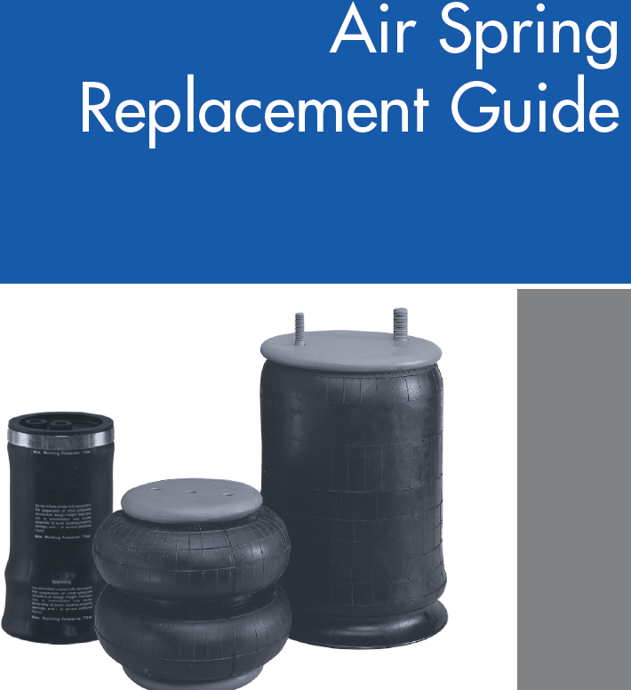
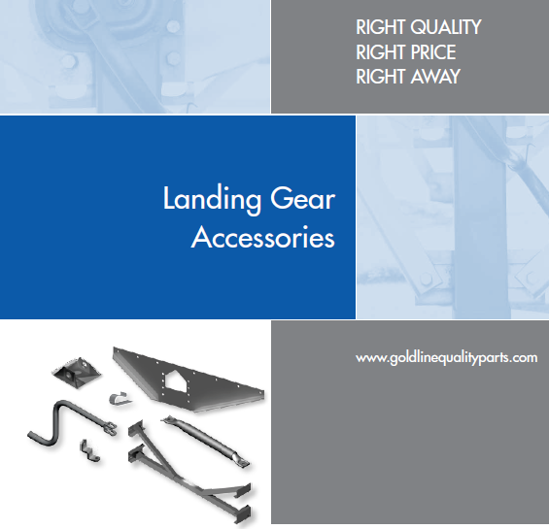
Gold Line Parts

Slide 16
Thank you very much
for your business.
We appreciate it!

