Slide 1
Jeff Barr – OES Sales Manager

Slide 2
Strengthen the Base Expand and Grow
STEMCO Strategy:
Strategic approach focusing on highly coordinated business unit strategies

Slide 3
Wheel End Products
High performance products for the commercial vehicle market since 1951
Voyager, Discover, Guardian HP and Grit Guard wheel seals
PRO-TORQ and ZIP-TORQ Advanced Axle Spindles
Defender, Sentinel, Traditional, and PSI Hub Caps
Heavy Duty Bearings
Hubodometer Mileage Counters
STEMCO engineers wheel end solutions designed to meet the performance expectations of almost every fleet in service of our effort — Making the Roadways Safer®.

Slide 4
Brake Products
STEMCO Brake Products™ provides application specific high performance braking solutions, and industry unique products and processes
CentriFuse® brake drums, B-Lock™ brake linings and Crewson™ brake adjusters, are providing an answer to the question, “how do I get quieter, safer, brake systems that run cooler and last longer?”

Slide 5
Suspension Products
Longest lasting, easiest to install no-ream steering knuckle king pins, spring pins and bushings
Easy-to-install Qwik Kit™ outperforms and outlasts the competition
STEMCO Gaff high performance polyurethane replacement parts for rubber undercarriage systems
Notes:
Way too many words. Bullet out information.

Slide 6
Innovative Tire & Mileage Solutions
A leader in the market focused on improving commercial vehicle fuel economy and increasing tire life.
Aeris ® - High performance tire inflation system.
BAT RF ® - Tire pressure monitoring system.
TrailerTail ® - Leading rear drag trailer aerodynamics tech in the industry

Slide 7
DataTrac® Pro
Field Programmable Electronic Hubodometer
Never Miss A Sale.
STEMCO introduces a new technologically advanced programmable mileage counter, the DataTrac® Pro Electronic Hubodometer. What makes the DataTrac® Pro Electronic Hubodometer unique is its ability to be programmed by the STEMCO Programmer to meet the customer's specific tire revolutions requirements.
Buy 24 and receive a FREE Programmer

Slide 8
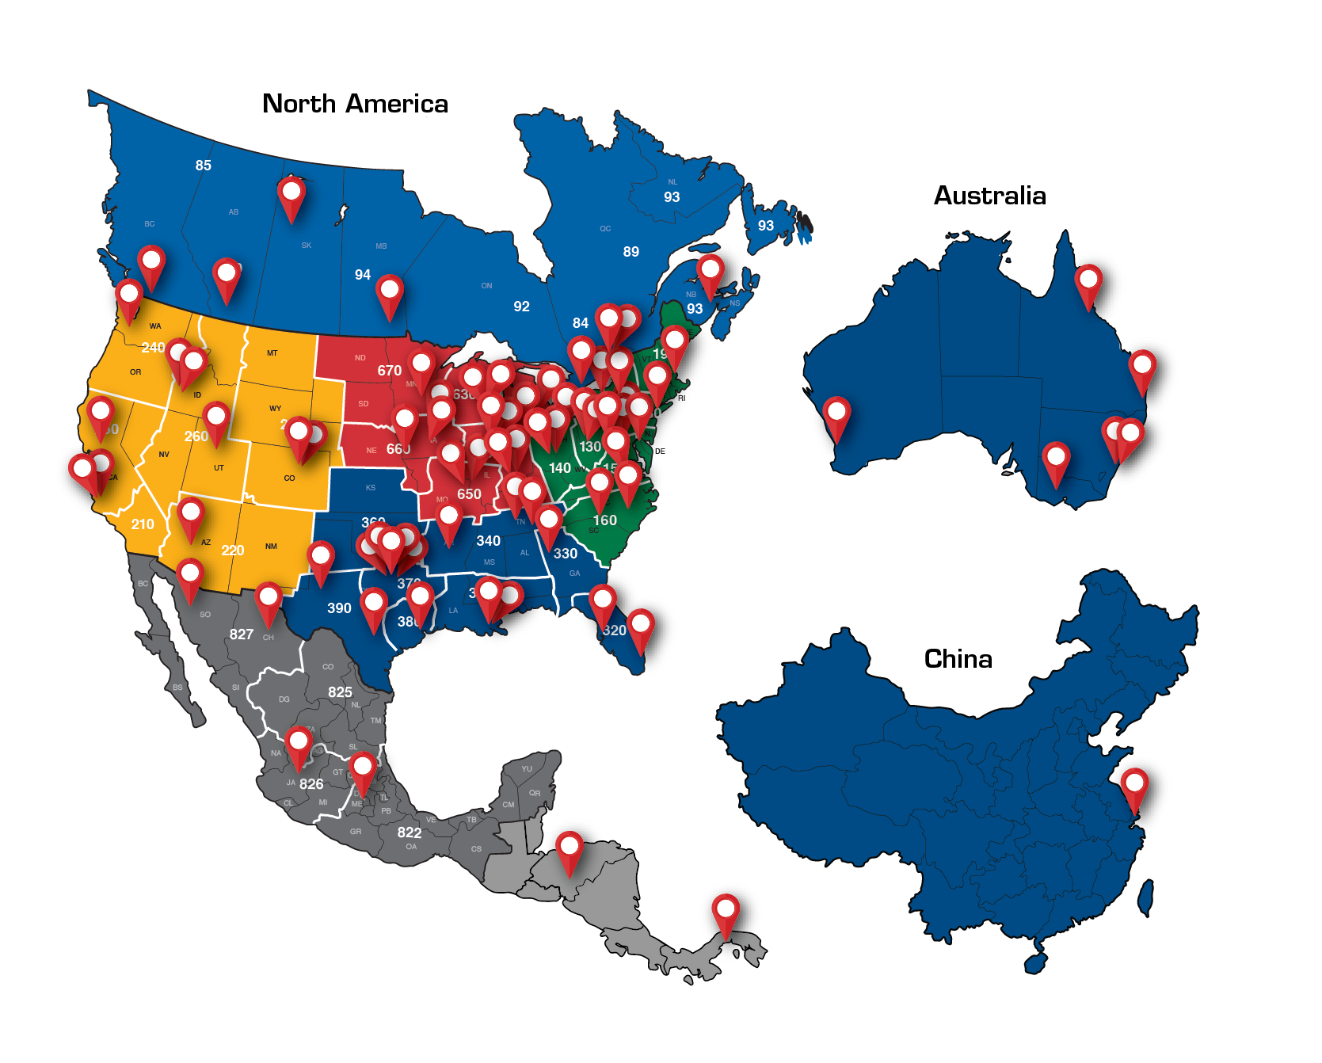
Customer Support
Field Support | Qty
District Sales Managers | 51
Regional Sales Managers | 6
Strategic Account Managers | 5
OEM Sales Managers | 5
Wheel End Specialists | 4
Brake Specialists | 4
Suspension Specialists | 4
ITMS (Tire & Aero) Specialists | 8
Tech Service | 7
Customer Service | 22
Total World Field Support | 116

Slide 9
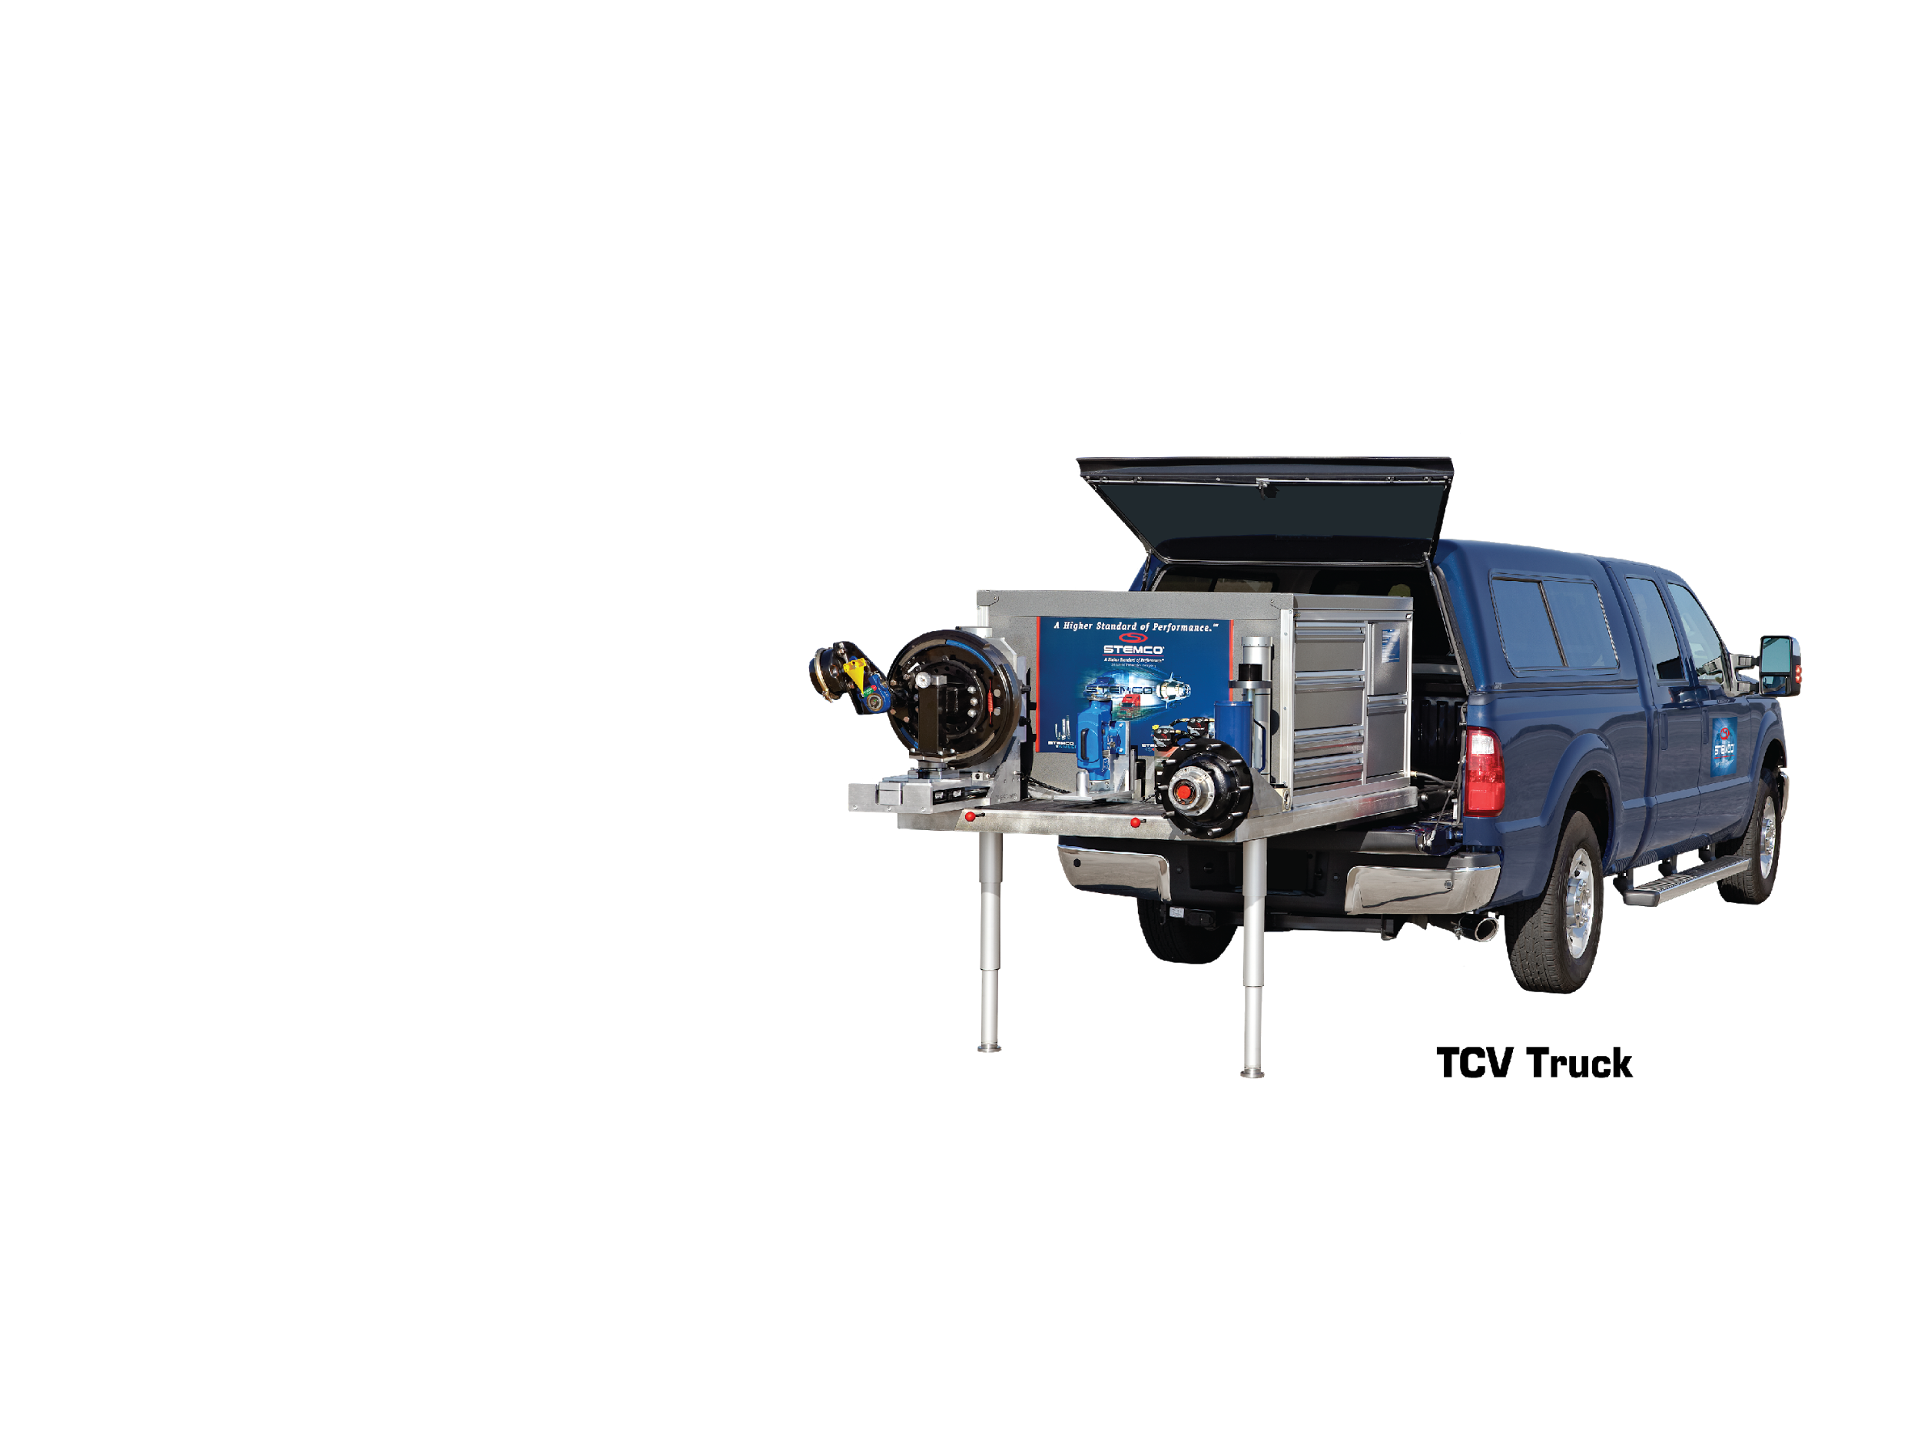
Field Sales Training
Key Highlights
Selling Focused on End-users
STEMCO U – In-person & Online
46 Training Trucks in North America
Professional Skills: Action Selling
Standardized, Consistent Training
TQM® Certification Training Includes: Wheel-ends, Brakes & Suspensions
On-site and On-demand
120 TQM Clinics A Week
80 U.S., 20 Canada, 20 Mexico
6,000 Per Year
50,000 Mechanics Trained

